Slide 1
PROJECT TITLE:
Data literacy with tableau
India’s Agricultural Crop Production Analysis(1997-2021)

Slide 2




TEAM PROFILE
NM TEAM ID :
NM2023TMID37300
TEAM LEADER
KATHIRVELAN.R
KIRUBAKARAN.G
KISHORE.S
KAVIYA SHREE.V

Slide 3
India's agricultural crop production has witnessed a significant growth over the past two and a half decades. The total food grain production in the country increased from 204.8 million tonnes in 1997-98 to 314.9 million tonnes in 2021-22, registering a growth of over 50%. This growth has been driven by a number of factors, including increased use of inputs such as seeds, fertilizers, and pesticides, improved irrigation facilities, and better crop management practices.
INTRODUCTION

Slide 4
PURPOSE
The goal is to provide a reliable and accurate prediction tool that assist users in navigation the competitive rael estate market and maximizing their returns.
The model should identity the key futures impacting house price and provide insights to aid decision marketing

Slide 5
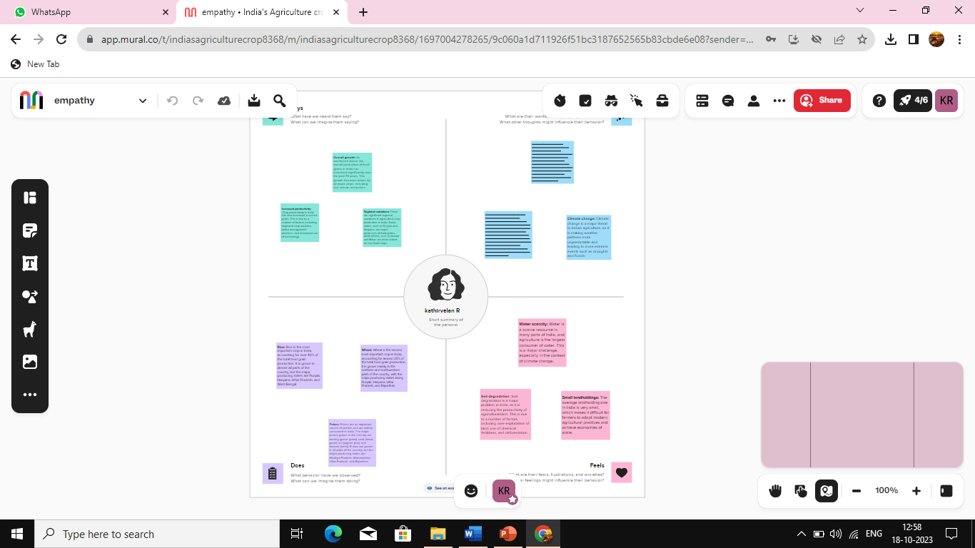

Slide 6
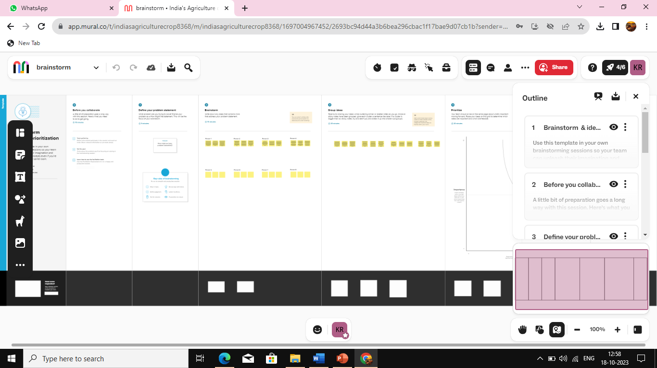

Slide 7
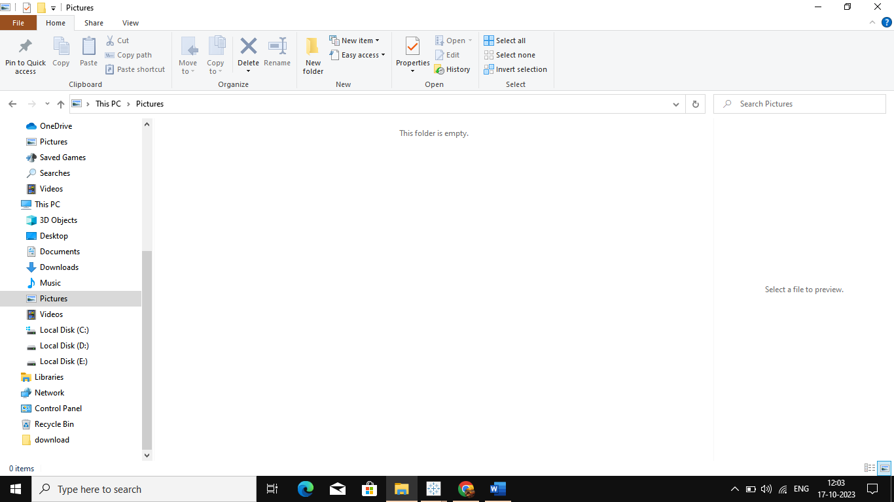

Slide 8
